Slide 1
Employee Data Analysis using Excel
1
STUDENT NAME: SOUMIYA D
REGISTER NO: 312209148
DEPARTMENT: COMMERCE
COLLEGE: ANNA ADARSH COLLEGE FOR WOMEN

Slide 2
PROJECT TITLE
EMPLOYEE SALARY ANALYSIS USING EXCEL

Slide 3


AGENDA
Problem Statement
Project Overview
End Users
Our Solution and Proposition
Dataset Description
Modelling Approach
Results and Discussion
Conclusion
3/21/2024 Annual Review

Slide 4

PROBLEM STATEMENT
This Project is being made to analyse the employee salary data to identify trends, disparities, and alignment with market standards, ensuring fair and equitable compensation practices for various job roles. This analysis aims to uncover any inconsistencies, provide fair and equitable compensations, align salaries with industry standards, and support strategic decisions for talent retention and satisfaction.

Slide 5

PROJECT OVERVIEW
Employee Salary Analysis project aims to evaluate the company's current compensation structure to ensure fairness, equity, and market competitiveness. The project involves collecting and analyzing employee salary data across various dimensions, such as job roles, departments, experience levels, and demographics. It seeks to identify any disparities, align salaries with industry benchmarks, and assess the effectiveness of performance-based compensation.
The outcome will provide actionable insights and recommendations for adjusting salary policies to enhance employee satisfaction, promote equitable pay practices, and support strategic business objectives, ultimately fostering a positive workplace and improving talent retention.

Slide 6
WHO ARE THE END USERS?
Employee
HR Department
Finance Department
Management
Labour Unions
Compensation and Benefits Team

Slide 7

OUR SOLUTION AND ITS VALUE PROPOSITION
Conditional Formatting – Blanks, Data Bars
Filtering – Removing Missing Values
Pivot Table – Department Wise Salary
Formula – Sumif
Bar Graph – Final Report

Slide 8
DATASET DESCRIPTION
EMP ID: Unique Identifier for each Employee in the
Organisation for each State.
NAME : Name of the Employee.
GENDER : Gender of the Employee (ie. Female, Male).
DEPARTMENT : The broader Category or type of Department the
employee’s work is associated with.
SALARY : Salary of the employee in dollars($).
EMPLOYEE TYPE : Different type employees an Organisation can
hire.
WORK LOCATION : Column representing the Physical location or
Office where the employee is based.

Slide 9

THE "WOW" IN OUR SOLUTION
Using Sumif formula We found Computation of total Salary in each State code.
Data Visualization – A Clear Analysis Of Salary.
3/21/2024 Annual Review
9

Slide 10
MODELLING
10
Dataset
Feature Selection: EMPLOYEE ID, NAME, GENDER, DEPARTMENT, SALARY, EMPLOYEE TYPE, WORK LOCATION(CITIES & STATES)
Table Design:
Borders
Table colour and fonts design
Assigned Currency to Salary
Separated Cities and Sates using Data-Text to Columns.
Conditional Formatting:
Highlighting text “Null” and Blanks.
Data Bars for Salary.
Filter : Filtering all blanks by selecting the cell colour.
10

Slide 11
Computation of Total Salary of Each State Using Formula:
=SUMIF(A2:A190,"TN*",E190) – Tamil Nadu
=SUMIF(A2:A190,“PR*",E190) – Puerto Rico
=SUMIF(A2:A190,“SQ*",E190) – San Marino City
=SUMIF(A2:A190,“VT*",E190) – Vermont
Creating Bar Graph.
Pivot Table – Department Wise Salary Summary
Slicer – Employee type and Work Locations.
Graph – Bar Graph .

Slide 12
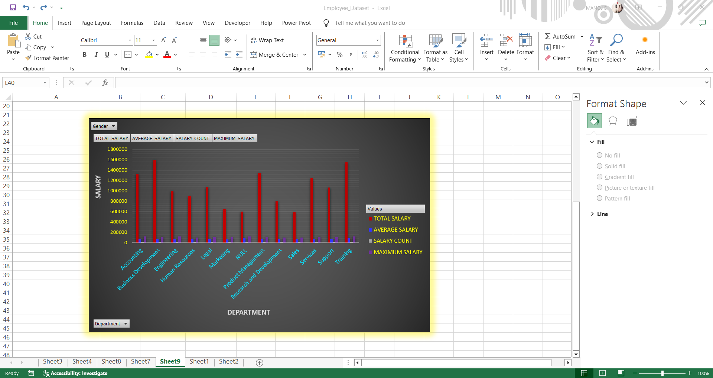
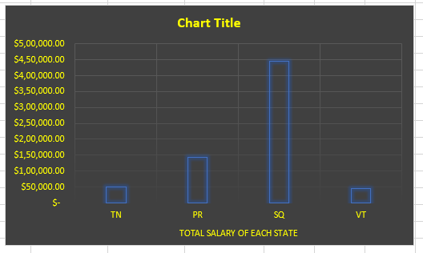
BAR GRAPH
RESULTS
12

Slide 13
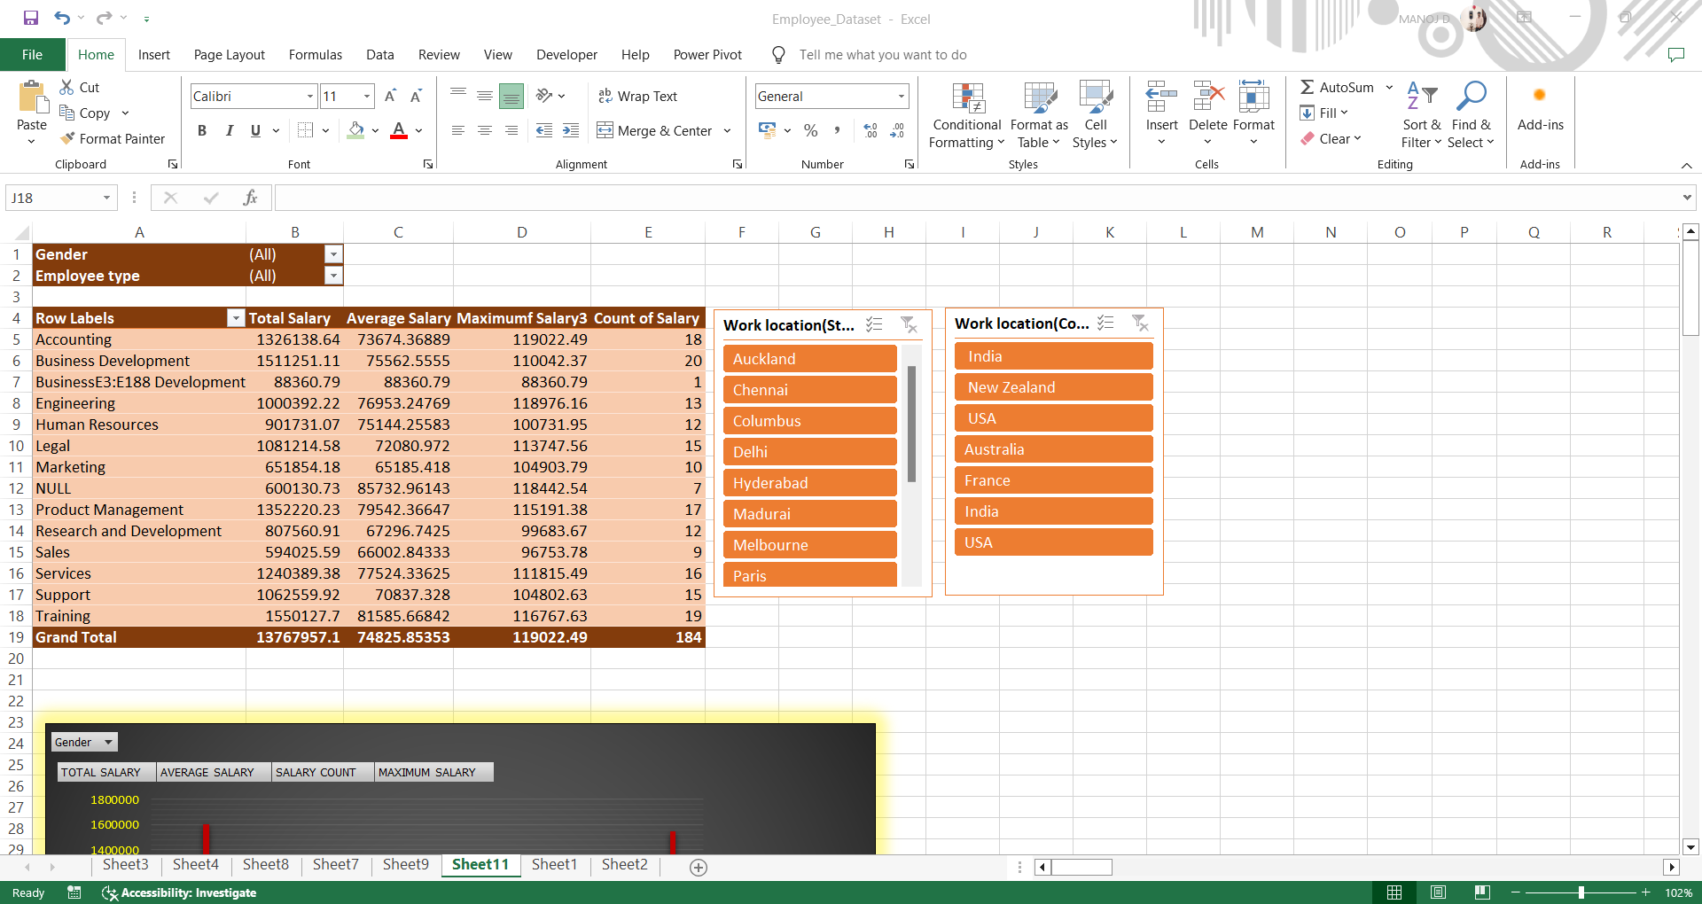
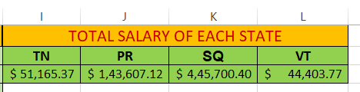
PIVOT TABLE AND SLICER
USING SUMIF

Slide 14
CONCLUSION
This Analysis reveals key trends in compensation, highlighting disparities across departments and roles. Through the Bar Graph Of Each State, It is evident that State San Marino City’s Salary is more Compared to Other three Sates. Through Bar Graph of Department Wise Report, Employees of Business Development Department Receives More Salary.
This Analysis Provides Insights on Investing in regular salary reviews and transparent policies will help retain talent and foster a fair and motivated workforce.

